Slide 1



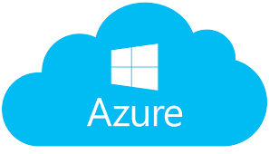


















Security Architecture Sample
3rd Party Tool
In-house Tool
Application
Database
App Server
Web Server
Accenture CIO Managed
In- House tools
Single Sign On (SSO)
oAuth2 Authentication
3rd Party tool
Azure Key Vault
OAuth2 and Https
Port: 443
Web Zone
App Zone
DB Zone
Web Apps (UI)
Https
Port: 443
Application Services
(REST API)
Port: 1433
SQL
Server DB
Employees
External Firewall
Azure Active Directory
ARR ( DMZ)
Load Balancer
Monitoring & Security Agents
Network & VMs Security
Database Security
Disk Encryption- BitLocker/DM-Crypt
DigiCert TLS – 2048 and SHA-2 Encryption
Network Security Group (NSG) , VNet and Subnets
Firewall
MSI Enabled VMs
Antivirus & Anti-malware
VM Backups & Patching
Application Vulnerability Scan (ASA, SAST, DAST, WAS)
Azure Baston connectivity to VM’s
Data Encryption (Transparent Data Encryption)
Alert Logic Threat Manager
Application Insight
Blob Storage
Log Analytics
Qualys
SCCM/SCOM
Tanium
AppDynamics
Websitepulse
SCEP

